Slide 1
Examination of the Components of the Fiscal Policy Paper which was laid before the Houses of Parliament on February 14, 2023

Slide 2
Auditor General’s Comments
I reviewed the Fiscal Policy Paper (FPP), which was laid before the Houses of Parliament on February 14, 2023, in accordance with the Financial Administration and Audit (FAA) Act.
The FPP met the requirements of the Third Schedule and included the minimum content under the Fiscal Responsibility Statement, Macroeconomic Framework and Fiscal Management Strategy.
I adhered to the standards issued by the International Association of Supreme Audit Institutions and International Standard on Assurance Engagement (ISAE) 3000.

Slide 3
Auditor General’s Responsibilities
Section 48B (6) of the FAA Act requires the Auditor General to examine the components of the Fiscal Policy Paper and provide a report to the Houses of Parliament indicating whether: -
The Conventions & assumptions underlying preparation of the FPP comply with principles of prudent fiscal management.
Reasons given for deviations from the Budget are reasonable, having regard to the circumstances.
There are public bodies that do not form part of the specified public sector that were part thereof in the preceding fiscal year.
A public private partnership involves only minimal contingent liabilities.

Slide 4
a) Regarding the conventions and assumptions underlying the preparation of the Fiscal Policy Paper
The principles of prudent fiscal management require the budget to be informed by reasonable revenue projections, underpinned by realistic macroeconomic assumptions, and that related risks and risk-mitigating measures are identified
For FY2023/24, nominal GDP growth of 9.1% (5.1% real) was projected in the context of a slowdown in the economic growth of advanced economies;
The pace of growth was forecasted to decelerate over the medium term to 6.1 per cent (1.0 per cent real) against the backdrop of weakened global growth, elevated domestic and international inflation, and a tightened monetary policy stance.

Slide 5
a) Regarding the conventions and assumptions underlying the preparation of the Fiscal Policy Paper (contd.)
The medium-term forecasts depicted Wage to GDP ratios of more than 11.0 per cent for FY2023/24 to FY2026/27, but no reference was made to the Wage to GDP legislative target of 9 per cent.
Relatively small buffers in the form of fiscal surpluses of $9.9bn and $8.5bn for FY2023/24 and FY2024/25, respectively, were noted relative to the $21.3bn surplus for FY2021/22.
Accordingly, the staff level agreement on a Precautionary and Liquidity Line (PLL) and the Resilience and Sustainability Facility (RSF) totalling US$1.7bn will provide important support to the budget.

Slide 6
a) Regarding the conventions and assumptions underlying the preparation of the Fiscal Policy Paper (cont’d)
The FPP identified slower than projected GDP growth as the main risk to fiscal and debt sustainability. This risk would be managed through continued monitoring of developments in the global economy to gauge spill over effects
Other risks indicated, include those related to inflation, interest rates, oil price and Government’s exposure to contingent liabilities for which risk-mitigating measures were also identified.
Consequent on the impact of the COVID-19 pandemic, four of the five existing concessionaires submitted claims or notice of their intent to claim under the provisions of the respective concession agreements. The imperative is for the claims to be properly assessed and managed, to not present a risk to the fiscal position and debt trajectory.

Slide 7
a) Regarding the conventions and assumptions underlying the preparation of the Fiscal Policy Paper (Cont’d)
Overall, I found that the conventions and assumptions underlying the preparation of the Fiscal Policy Paper FY2023/24 complied with the principles of prudent fiscal management.

Slide 8
b) Regarding explanations for deviation in revenue for April-Dec 2022 vis-a-vis Original budget
The FPP attributed the general overperformance of revenue to the country’s strong recovery from the effects of the COVID-19 pandemic, as well as policies to address the economic impact of the Russia-Ukraine conflict
Stronger than budgeted Production & Consumption taxes were reportedly fuelled by higher consumption associated with increased employment while Education
Tax receipts also reflected labour market improvements
The greater than budgeted non-tax revenue was attributed to higher than projected inflows from de-earmarked companies and miscellaneous revenue.
Stronger than expected grant receipts reflected greater than expected disbursements from the European Union and Caribbean Development Bank.

Slide 9
Explanations for deviation in revenue for April – Dec 2022 vis-a-vis Original budget
Overall I found the explanations for the deviations relative to Budget to be reasonable, having regard to the circumstances.

Slide 10
c) pursuant to my application of criteria prescribed pursuant to regulations made under Section 50 (1), there are public bodies that do not form part of the specified public sector, and identifying those bodies (if any) which in the preceding financial year formed part of the specified public sector:
The Auditor General assessment confirmed that both JMB and the BOJ carry out functions primarily of a commercial nature as required by Regulations 14(2) of the FAA (FRF).
Auditor General’s certification for JMB Limited and BOJ was submitted to the Minister of Finance on September 29, 2022, and the report was tabled in Parliament on October 11, 2022.
The FAA Act requires the Minister, no later than August 31, in every third year, to provide the Auditor General with a list of public bodies that the Minister wishes the Auditor General to consider for certification

Slide 11
d) a public private partnership involves only minimal contingent liabilities
The FAA Act requires the Auditor General to assess whether ‘a public private partnership (PPP) involves only minimal contingent liability accruing to the Government’.
The FPP identified that the Jamaica Ship Registry was being considered as a “user pays” PPP but is no longer being pursued via PPP.
GOJ indicated that alternative means of privatization will be explored.

Slide 12
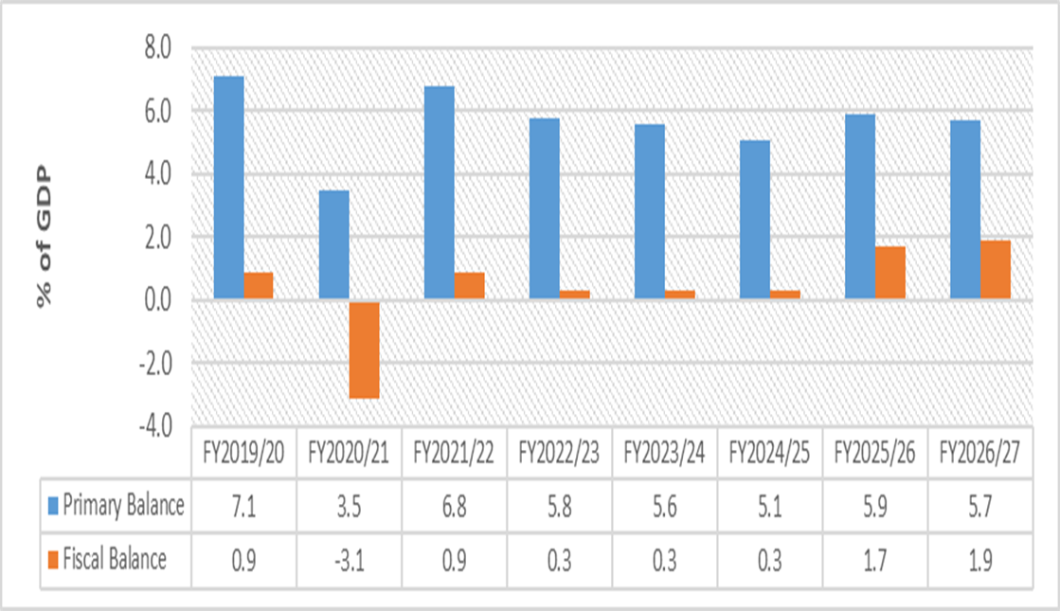
Fiscal Management Strategy For April to December 2022, the primary balance was $62.6 billion above target (110.4 %) whereas the fiscal balance was better than target by $55.5 billion (136.9 %). For FY2022/23, the estimate is for the fiscal surplus to be largely in line with the original budget based on higher than budgeted expenditure of 12.5 per cent and higher revenue by 12.4 per cent. The higher estimated primary balance for FY2022/23 reflects the higher estimated interest payments.
Primary and Fiscal Balance

Slide 13
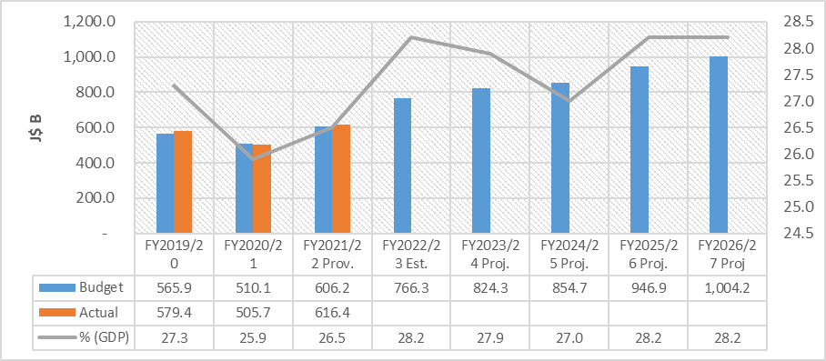
Tax revenue for the period April to December 2022 outperformed target by $52.1 billion (11.2 per cent). Tax performance reflected higher than projected outturns in all three major tax categories: International Trade, Income & Profits and Production & Consumption. Tax Revenue is projected to fall to 27.9 per cent in FY2023/24 and then increase to 28.2 per cent by FY2026/27
Tax Revenue

Slide 14
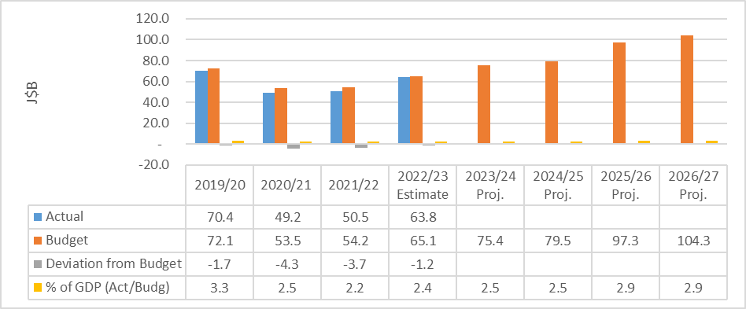
Capital Expenditure for April to December 2022 was $5.9 billion (13.9 per cent) less than originally budgeted which the FPP FY2023/24 attributed to a deceleration in the pace of execution for several planned projects.. Capital Expenditure is projected to gradually increase over the medium-term; however, both in dollars and as a percentage of GDP, the projections represented a downward revision when compared to the projections in the previous FPP.
Capital Expenditure

Slide 15
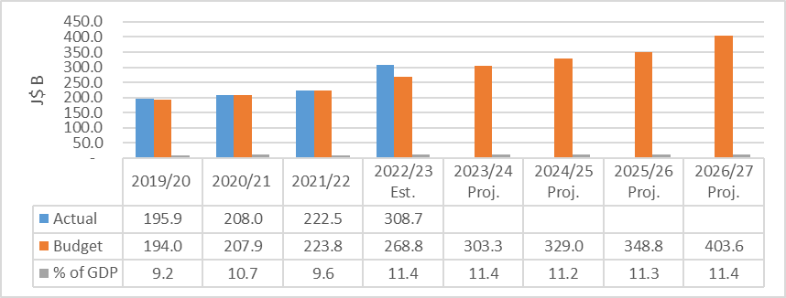
For April to December FY2022/23, Wages and Salaries exceeded original budget by $2.3 billion (1.1%). Wages and Salaries for FY2022/23 was estimated to be $39.9 billion, or 14.8% above the original budget, largely reflecting further payments to be made under the Public Sector Compensation Reform. Wages and Salaries has consistently exceeded the legislated target of 9 per cent over the years and is projected to remain above the target over the medium-term.
Wages and Salaries

Slide 16
Public Debt is estimated to end FY2022/23 at 79.7 per cent of GDP. This estimated debt to GDP ratio represents a downward revision by 7.6 percentage point relative to the 87.3 per cent projected in the FPP FY2022/23. The current estimates also represent a 4.4 percentage point improvement relative to the estimates presented in IMF Article IV 2022 consultation review.
Public Debt

Slide 17
Recommendations
The FPP should disclose the government’s intention for the wage to GDP legislative target of 9 per cent, given the current and projected breach over the medium-term.

Slide 18
‘A better Country through effective audit scrutiny’

