Slide 1
Effectiveness of Jamaica’s Institutional Framework in Enabling a Strong and Resilient National Public Health System
Performance Audit Report 2023 March 14

Slide 2
Understanding Health Systems Resilience
The ability of countries “to mitigate, prepare, respond and recover from disruptive events with public health implications, while maintaining the provision of essential functions and services and using experiences to adapt and transform the system for improvement”.
World Health Organisation (WHO) definition

Slide 3
Audit Objective
Given the threats of public health emergencies on the country’s health security, the overall objective of the audit is to assess:
The adequacy of Jamaica's institutional capacity to ensure the resilience of the public health system.
The extent to which Jamaica's institutional framework is progressing to building a strong and resilient public health system.

Slide 4
Key Audit Focus
Framework
National frameworks and regulations supporting health systems resilience
Policy & Plan
Policies and plans at the sub-national level to foster integration for health system resilience
Monitoring
&
evaluation
Promoting health system resilience in monitoring and evaluation
Implementation and Operational level
Infrastructure and infostructure capacity to support health system resilience
WHO health systems resilience toolkit

Slide 5
What we found

Slide 6
The Government established a legislative structure for public health and has set the foundation to build a resilient public health system by outlining the policy framework, in the Vision 2030 National Development Plan (NDP), to strengthen the healthcare system.
National framework

Slide 7
National framework
Legal and policy frameworks in place to build a resilient public health system.
Vision 2030 NDP incorporates Jamaica’s public healthcare policy framework.
Range of emergency operational plans, policies, protocols, and manuals are in place to respond to various diseases.
No repository where public healthcare administrators can access updated versions of operational policies, protocols, and manuals.
Absence of assessment and documentation of lessons learnt from health emergencies.

Slide 8
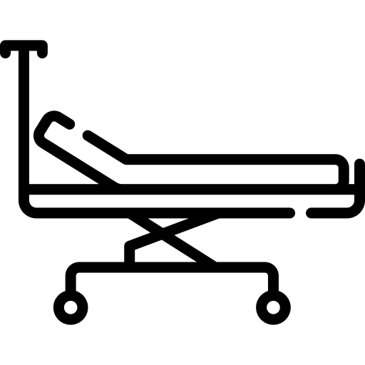
Infrastructure Capacity
Hospital bed capacity and doctor/nurse-to-population densities impacting the resilience of the public health system.
Analysis of PAHO’s data shows that Jamaica had 1.68 hospital beds available for every 1,000 persons in the population in 2021.
Jamaica’s density ratio of 2.71 doctors and nurses per 1,000 population is below the minimum density ratio of 4.45 skilled health worker recommended by the WHO.

Slide 9
Infrastructure Capacity
Health system strengthening programme to improve health facilities impacted by delays in implementation and funding gaps.
Health facilities are working in silos due to the absence of an integrated information system to facilitate the sharing of critical information such as patients’ records.
Slow implementation of actions to improve healthcare service to the vulnerable in emergencies.

Slide 10
Infrastructure Capacity
Administrative weaknesses in how MoHW and RHA’s handled the maintenance of public health facilities, medical equipment and patients’ complaints, which are critical to the effective delivery of healthcare services.
Poor planning for preventative and corrective maintenance of health facilities and medical equipment.
Absence of a coordinated approach for the effective management of patient complaints.

Slide 11
Health Financing Strategy
Although the Government allocated $359 billion between 2016-17 and 2020-21 to fund public health, resource gap remains a challenge.
Jamaica health expenditure to GDP ratio over the period 2015-2019 is 2.18 percentage point below PAHO recommended benchmark of six percent.
Jamaica health financing strategy needs strengthening taking into consideration the guidance provided by the WHO on health financing strategies in building health systems resilience.

Slide 12
Conclusion
Jamaica’s progress towards strengthening its public health system has been slow, exacerbated by the Covid-19 pandemic. Hence, more needs to be done if the country is to achieve the NDP health-related targets to improve the resilience of the public health system by year 2030.

Slide 13
What should be done
Better coordination and resource planning using a Whole-of-Government Approach (WGA)
Better coordination is urgently required among key stakeholders, particularly MoHW and MoFPS, to implement the health-related actions under Vision 2030 NDP to build the capacity and the resilience of the public health system and to achieve the targets by year 2030.

Slide 14
What should be done
Learning from experience to adapt and improve
MoHW should incorporate post-event reviews to aid in its response and recovery efforts by properly documenting and analysing lessons learnt from health emergencies and use the information to adapt and transform the public health system.

Slide 15
What should be done
Address administrative weaknesses
There is an urgent requirement for MoHW and RHAs to fix the administrative weaknesses identified in the handling of preventative and corrective maintenance of public health facilities and medical equipment and managing patients’ complaints, which are critical to the effective delivery of healthcare services.

Slide 16
‘A better Country through effective audit scrutiny’

