Slide 1
Year In Review Key Audit Issues
Auditor General’s Department
of Jamaica
Annual Report 2018

Slide 2
Reporting the issues by Themes
Governance
Project Management
Procurement & Contracts Management
Information & Communication Technology
Resource Management

Slide 3
Outstanding Appropriation Accounts and Monthly Financial Statements
Weaknesses in management of Deposit and Bank Accounts
Non-adherence to GoJ Guidelines on reallocation of funds
Regulatory breach in submission of Appropriation Accounts
*Salary Overpayment *Un-cleared Advances *Inadequate Controls over Revenue
Slow implementation of project activities
*Nugatory expenditure *No approval seen for excess expenditure of $100.15 Million
Governance
Issues
There is a need for greater oversight and monitoring of Government programmes and activities to ensure transparency and accountability in the use of public resources.

Slide 4
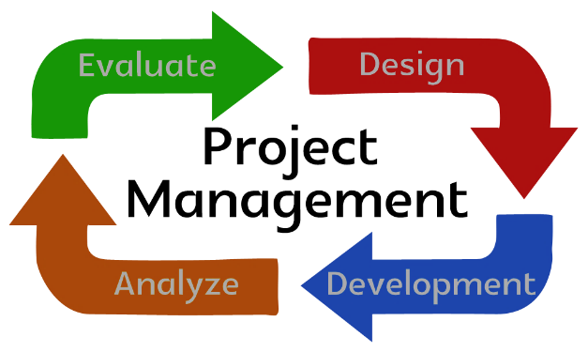
Unachieved targets and Infrequent Project Steering Committee Meetings
Slow implementation of project activities
Risk of Losing
Grant Funding
Disbursement
Linked Targets not achieved
MLGCD overpaid $7.1M in rent over a two-year period for the newly-leased space.
Project Management
Issues
Two major themes were noted for special attention – planning, evaluation, implementation and monitoring based on intrinsic weaknesses which have been identified in audits conducted over the last five years.

Slide 5
Long Outstanding Aged Payables
Inadequate Controls over Revenue & Lack of effective monitoring of Advance Accounts
Payments totalling $1.3M made without formal agreement
Stock count was not conducted to substantiate inventory balance of $94M
Overpayment to Early Childhood Practitioners was approximately $28M as at March 31, 2018
Resource Management
Issues
Various control elements have been implemented by the GOJ to monitor and manage resources, however, administrative, financial and operational management inefficiencies have been common deficiencies identified in audits over the last five years.

Slide 6
Procurement Management
Breaches of the Procurement Guidelines in the award of contracts.
Contracts Management
Poor planning and executions of projects
Procurement & Contracts Management
Issues
A common weakness found was that the procurement process though clearly documented was not always fair, transparent and open to competition.

Slide 7
Absence of an IT Oversight Committee - JCF
Unapproved IT Policies and Procedures - JIS
Absence of IT Strategic Planning - JCF
Informal IT Risk Assessment
Inadequate IT Security Function – MoFPS
Inadequate IT Security Incident Response System – JIS
Limited IT Security Training and Sensitization
Inadequate Controls over Administrator Accounts and Activities
Inadequate Information Security Controls in the Disposal of ICT Equipment
Inadequate Access Controls
Information & Communication Technology
Issues
The weaknesses identified under this theme were Information System Acquisition & Implementation, Information Security, Business Continuity and IT Disaster Recovery Planning, E-Commerce and Third Party Service Management.

Slide 8
‘A better Country through effective audit scrutiny’

