Slide 1
National Health Fund (NHF) Performance Audit Management of the Supply and Distribution of Pharmaceuticals and Medical Sundries
Auditor General’s Department

Slide 2
Summary
The National Health Fund Act was amended in 2011 to allow for a transfer of the assets and liabilities of the Health Corporation Limited (HCL) to the NHF, which assumed responsibility for the procurement, warehousing and distribution of pharmaceuticals and medical sundries.
The performance audit covered the period FY2011/12 to FY2016/17. The audit sought to determine whether the NHF’s Pharmaceutical Division efficiently and effectively managed its supplies and distribution of pharmaceuticals and sundries to support the delivery of quality public health, which accords with Vision 2030 National Development Plan.

Slide 3
Key Findings
NHF improved its management of spoilage
NHF reduced the level of spoilage of existing stocks to 0.1 per cent in FY2015/16 from 0.9 per cent in FY2012/13, well within its target of 0.6 per cent of average inventory.
The reduction in the level of spoilage was achieved through zoning and the First expired - First out (FEFO) methodology for stocking which requires goods with the earliest expiry dates to be sold first.

Slide 4
NHF’s Spoilage Levels
FY2012/13
Average Inventory-$663.2 million
Expired Items Value$6.4 million
Spoilage-0.9%
FY2014/15
Average Inventory-$742.3 million
Expired Items Value-$11.2 million
Spoilage-1.5%
FY2013/14
Average Inventory-$708.9 million
Expired Items Value-$5.8 million
Spoilage-0.8%
FY2015/16
Average Inventory-$1,099.9 million
Expired Items Value-$1.1 million
Spoilage-0.1%

Slide 5
Key Findings
NHF’s supply of essential drugs was inconsistent
NHF’s service levels for critical items and chronic illnesses remained below the 90 per cent target for FY2016/17, at 80 per cent and 84 per cent, respectively, but improved relative to 73 per cent and 75 per cent for the previous year.
NHF’s failure to meet service level targets over the review period arose from factors such as (a) credit holds by suppliers; (b) timing of customs clearance; (c) global shortages and (d) inaccurate inventory levels.
Some suppliers withheld orders, as NHF did not make timely payment for purchases 95.8 per cent of the time between FY2013/14 and FY2016/17. There were 56 instances in FY2015/16, where pharmaceuticals and sundries were out of stock due to such delays.

Slide 6
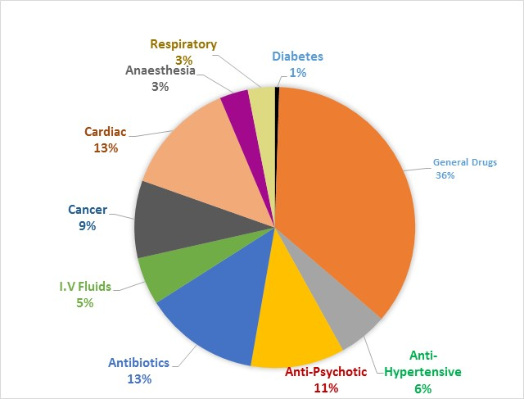
Stock-out of critical and chronic illness items

Slide 7
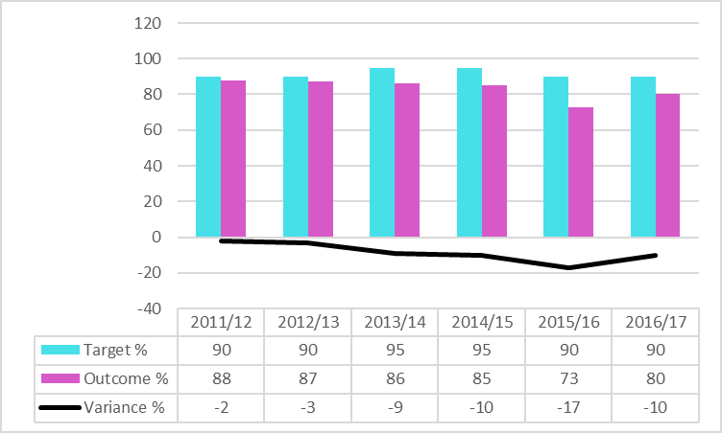
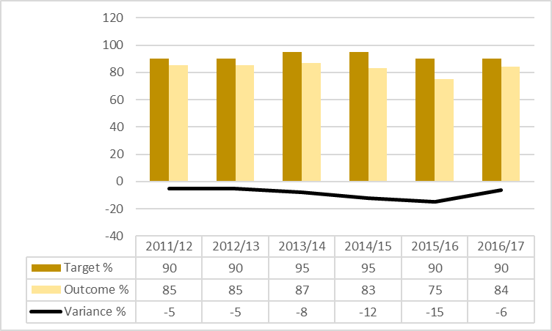
Critical and Chronic Illness Service Levels

Slide 8
Key Findings
Trade receivables were outstanding for an average 222 days in FY2016/17 of which 94.0 per cent was due from Ministry of Health (MOH). NHF wrote off $2.0 billion of the outstanding trade receivables due from MOH in FY2016/17.
Our analysis of internal audit reports for FY2013/14 found an 87.3 per cent inventory accuracy level, whereas for FY2016/17, the accuracy level was 73.2 per cent of inventory.
NHF only filled an average 65.2 per cent of orders from health facilities during the period FY2011/12 to FY2016/17. We identified 582 incidents of pharmaceuticals and sundries being out of stock for FY2015/16.

Slide 9
Recommendations
The NHF must apply greater control over its inventory management processes that will assure public health facilities and patients of an adequate and consistent supply of pharmaceuticals and sundries.
NHF must move with alacrity to secure a permanent solution to the problem of receivables outstanding from the MOH.

