Slide 1
Performance Audit of The Students’ Loan Bureau (Jamaica)

Slide 2
SLB Audit
The Auditor General’s Department is conducting a performance audit of the Students’ Loan Bureau (SLB), which provides loans through its Revolving Loan Fund to approved students pursuing tertiary education.
The audit is scheduled for publication in the first Quarter FY2018/19.

Slide 3
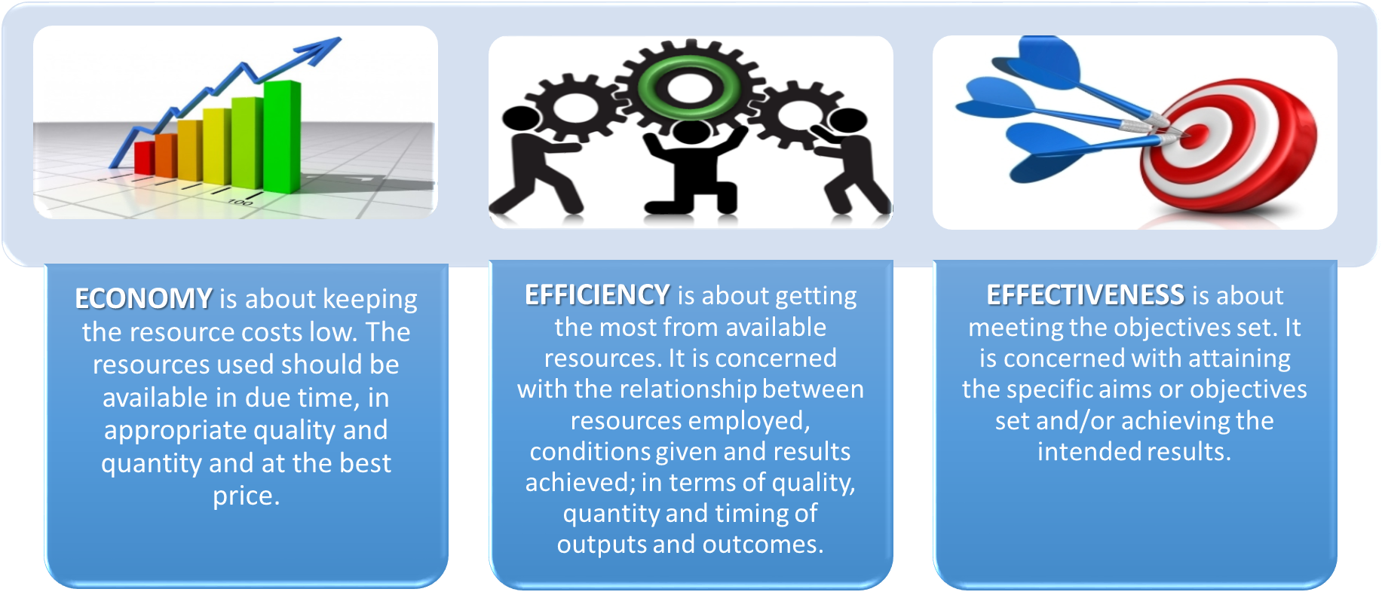
The Performance Audit will seek to provide assurance on the three E’s

Slide 4
Overview of the SLB
Mandate
Funding
Operational Context
To provide affordable financing to eligible students to pursue tertiary education through a sustainable Revolving Loan Fund (RLF).
Loan repayments by beneficiaries;
Loans from domestic public and private entities and external financial institutions
Vision 2030 Jamaica National outcome # 2: World-Class Education & Training and National Strategy 2.7: Ensure that Adequate and High Quality Tertiary Education;
UN Sustainable Development Goal (SDG) # 4 – Ensure inclusive and quality education for all and promote lifelong learning.

Slide 5
Audit Scope
The audit will seek to determine if SLB has in place, an efficient and effective loan management system that will enable a sustainable supply of loans for tertiary education and contribute to nation building.
The audit will also contribute to the AuGD’s strategic aim to promote improvements in the use of public funds
The audit will focus on three key Thematic Areas – Governance; Resource Management
and Information & Communications’ technologies

Slide 6
Audit Objective
Assess adequacy of SLB’s risk management framework
To identify if SLB is collecting sufficient funds to sustain its provision of loans to qualified applicants;
To identify what mechanisms are in place to reduce delinquency and periodically review sustainability of the RLF
Assess the reliability and adequacy of IT System and infrastructure
To identify whether effective and efficient systems are in place to monitor loans and process information
To identify If student records are up-to-date and properly maintained to trace and track details relating to loan disbursement, repayments, balances, as well as generate reports.

Slide 7
We welcome your

